Slide 1
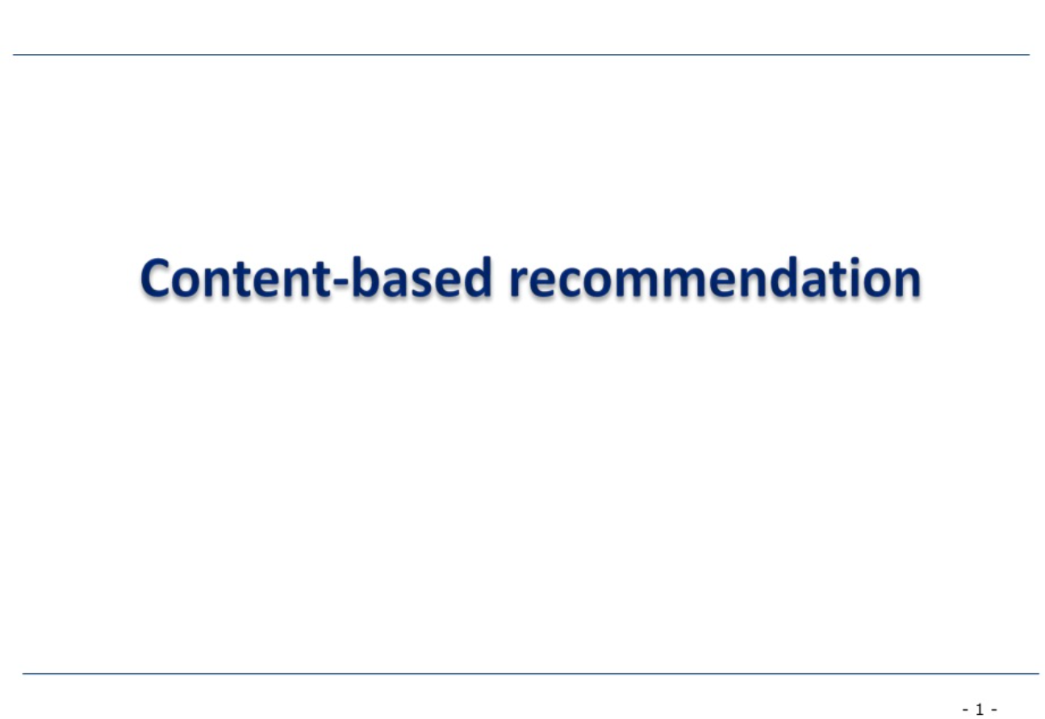
Michelle K Bliss

Slide 2
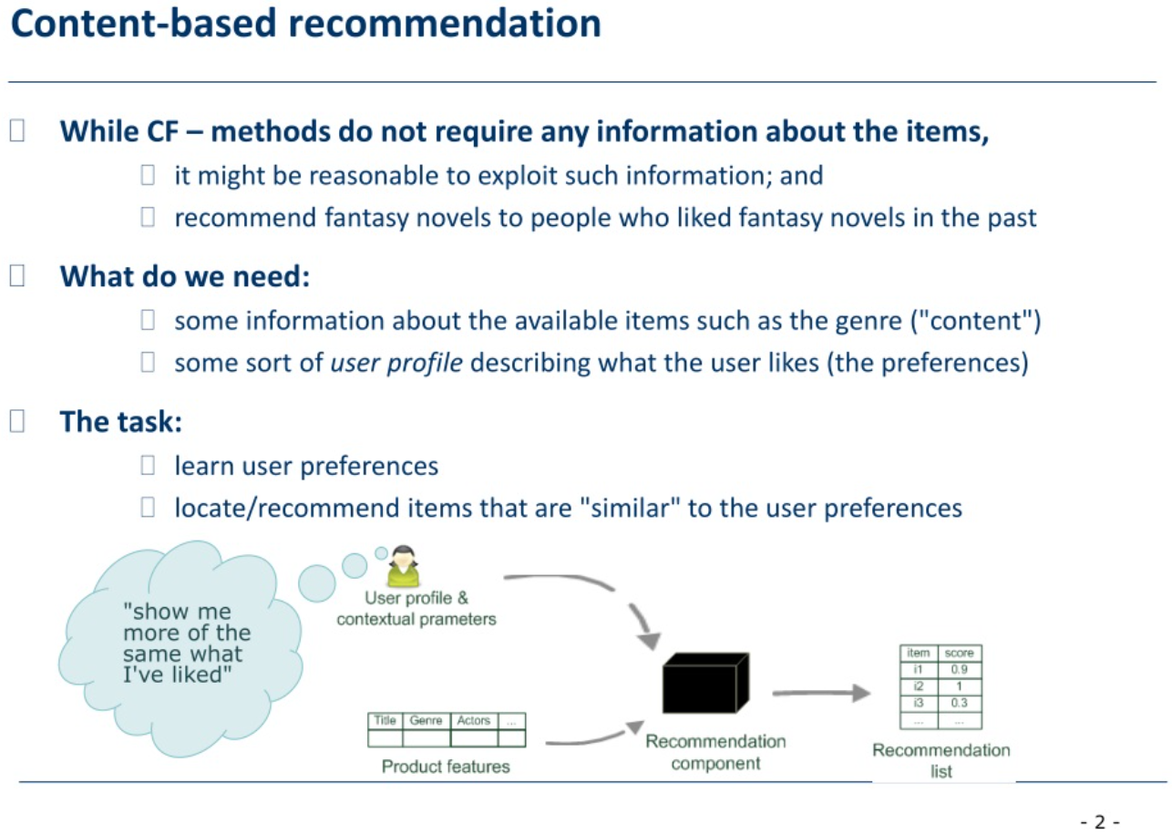

Slide 3
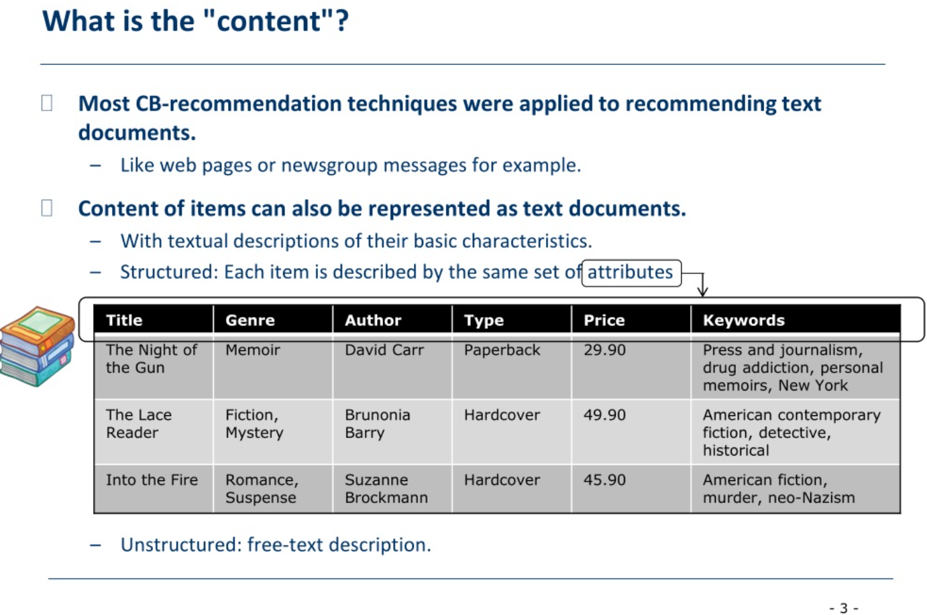

Slide 4
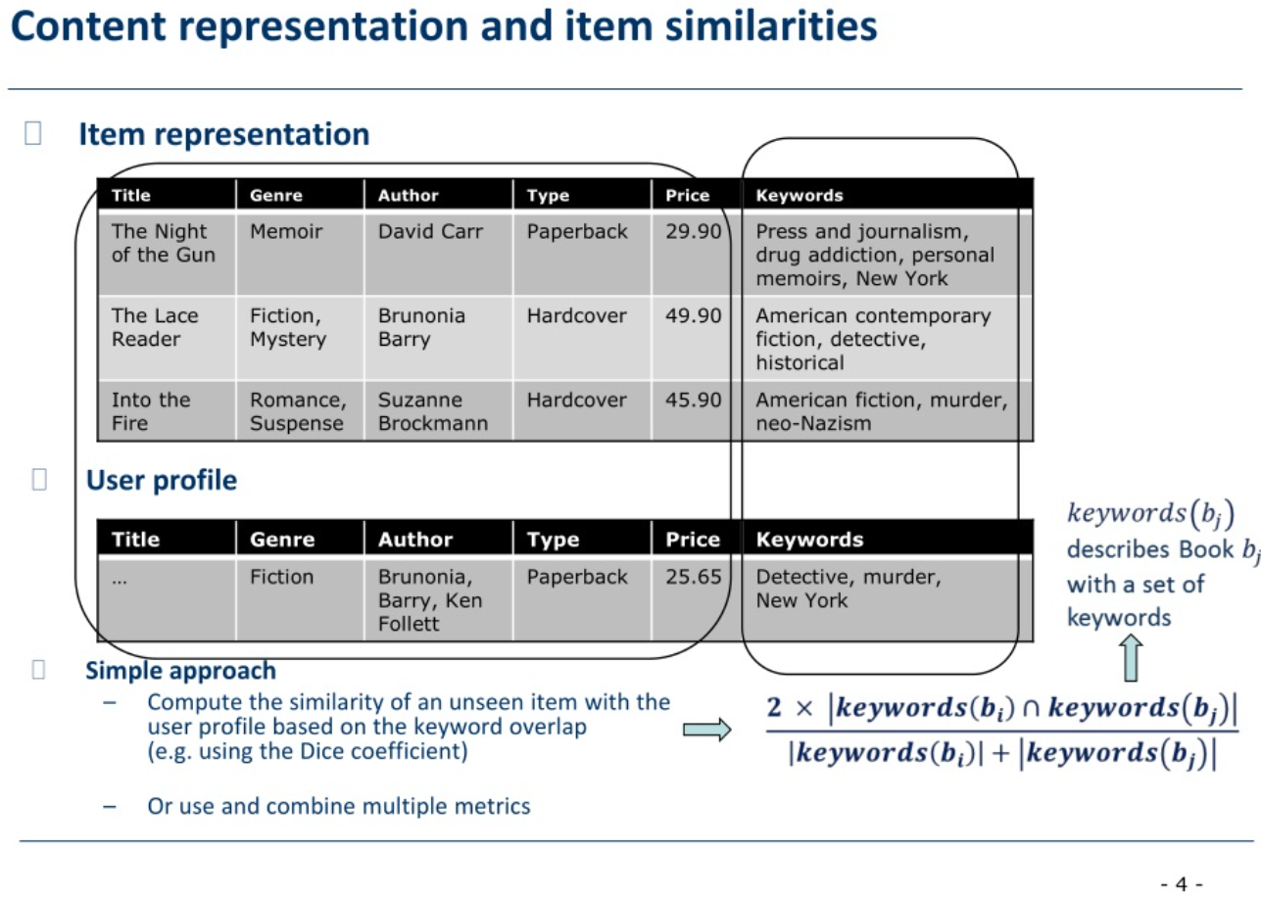

Slide 5
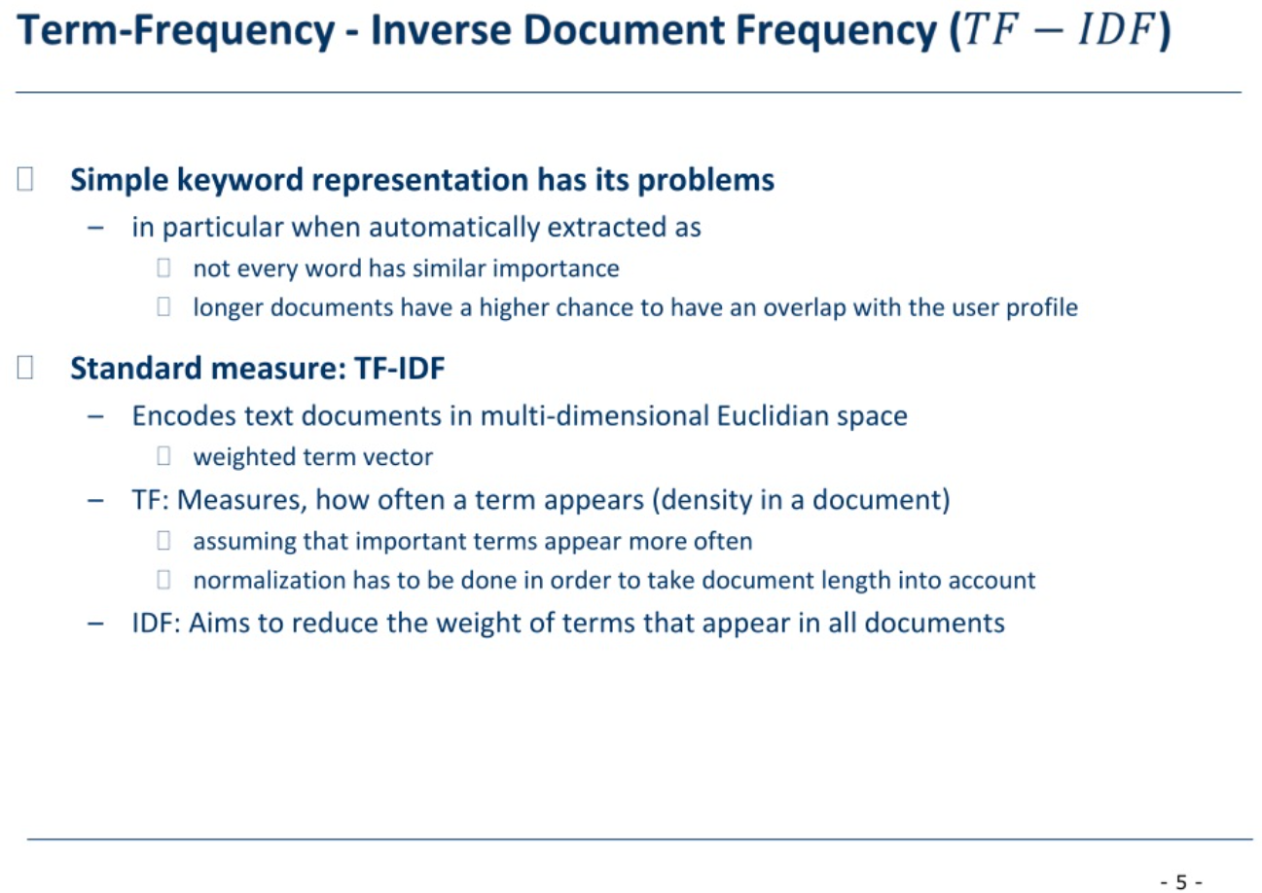

Slide 6
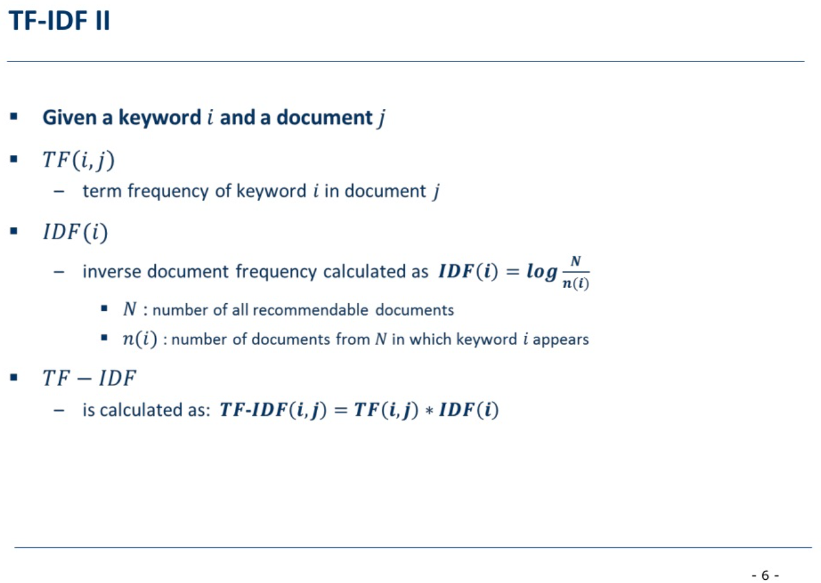

Slide 7
TF-IDF III
TF-IDF in practice
  https://scikit-learn.org/stable/modules/generated/sklearn.feature_extraction.text.TfidfVectorizer.html
  https://towardsdatascience.com/natural-language-processing-feature-engineering-using-tf-idf-e8b9d00e7e76
  https://www.projectpro.io/recipes/use-tf-df-vectorizer
  https://www.youtube.com/watch?v=vZAXpvHhQow
-7-

Slide 8
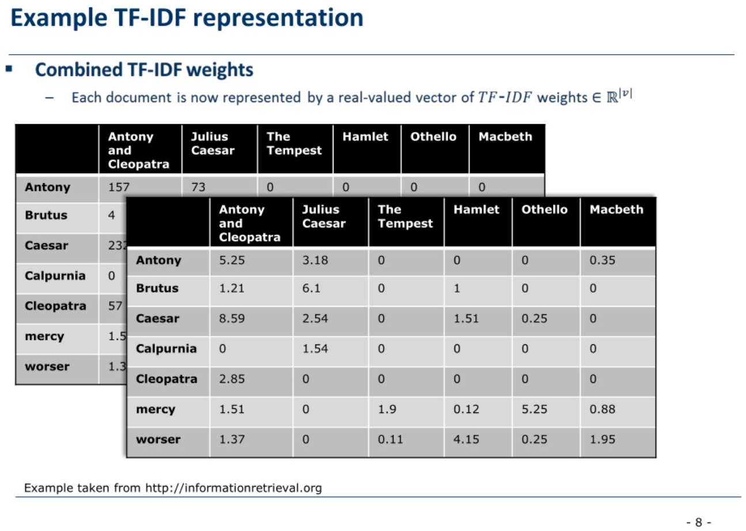

Slide 9
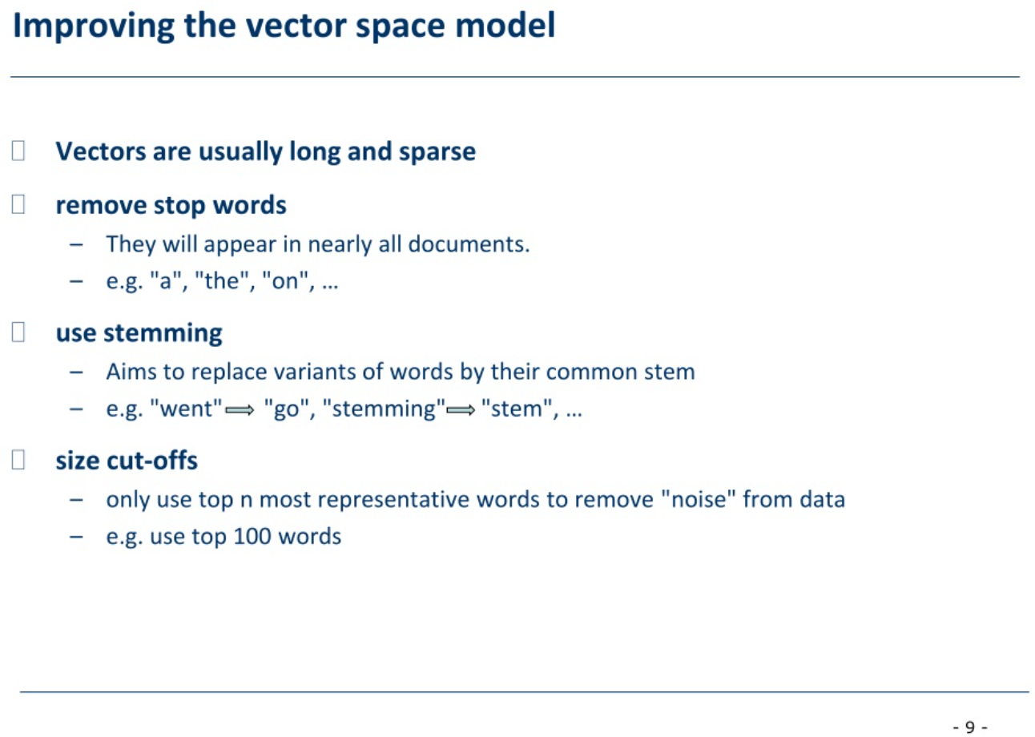

Slide 10
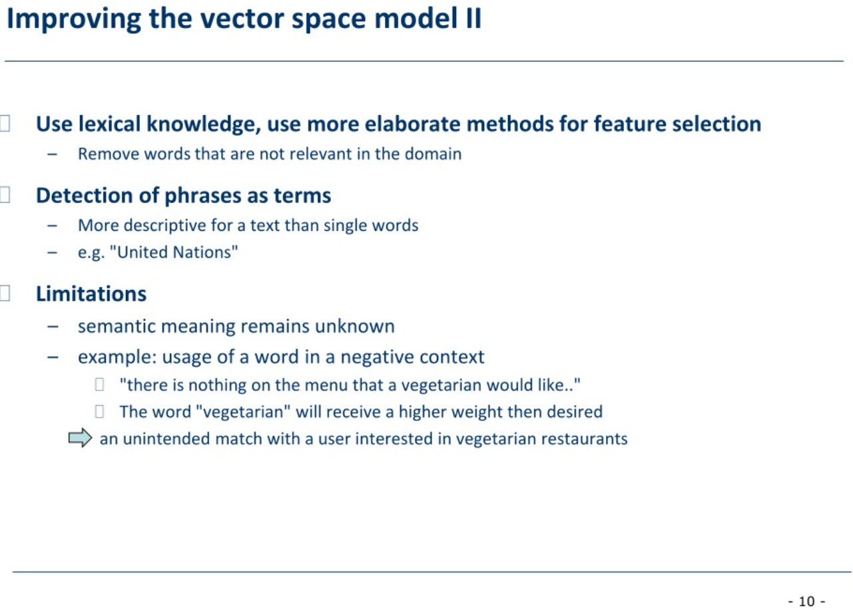

Slide 11
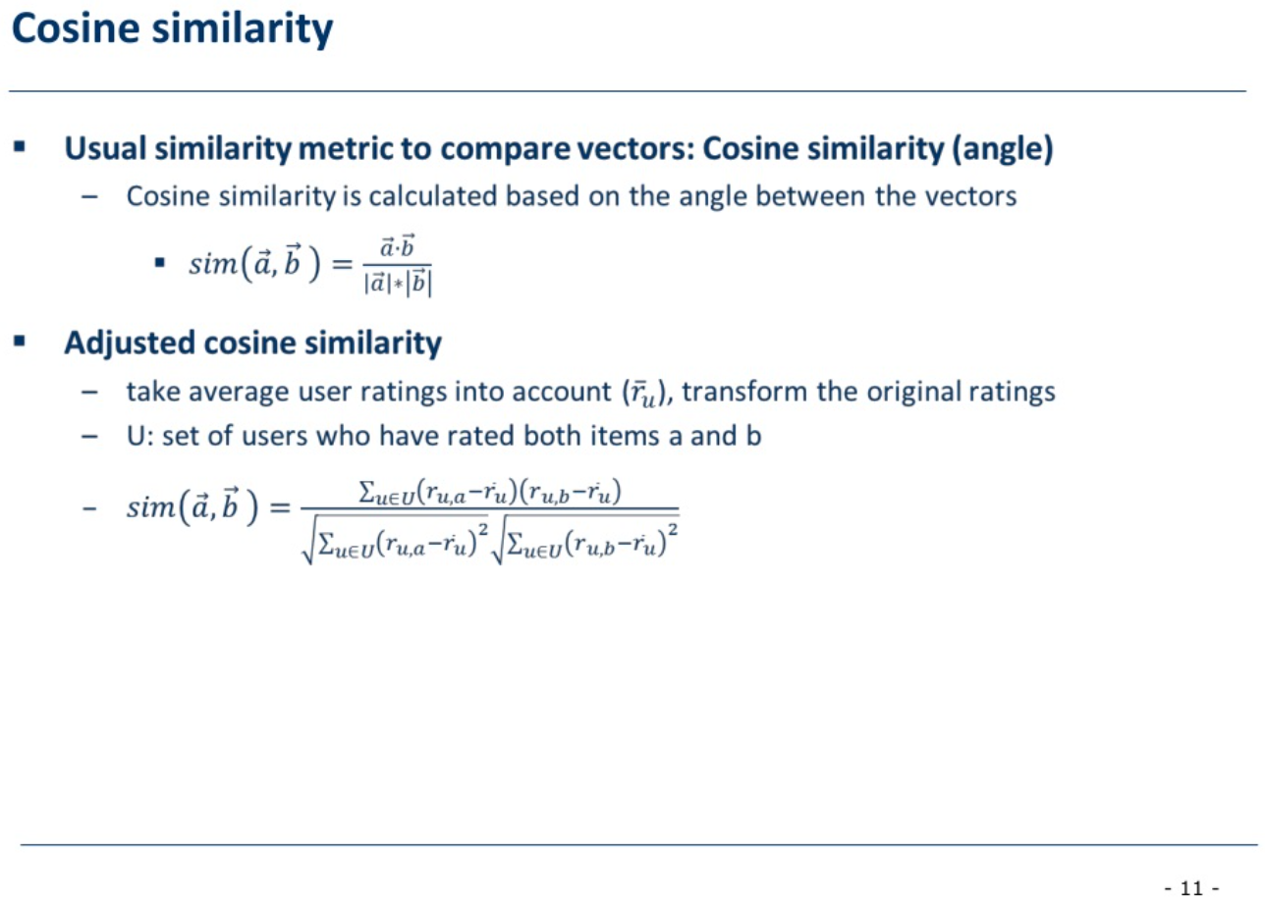

Slide 12
Similarity in practice
  Cosine similarity in practice
  https://scikit-learn.org/stable/modules/generated/sklearn.metrics.pairwise.cosine_similarity.html
  https://www.learndatasci.com/glossary/cosine-similarity/
-12-

Slide 13
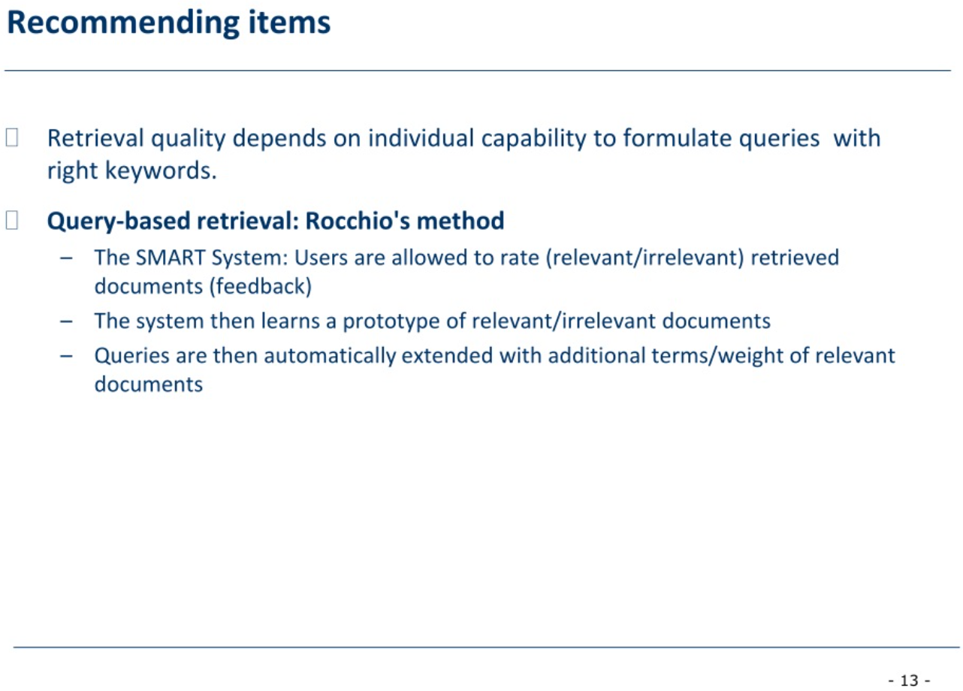

Slide 14
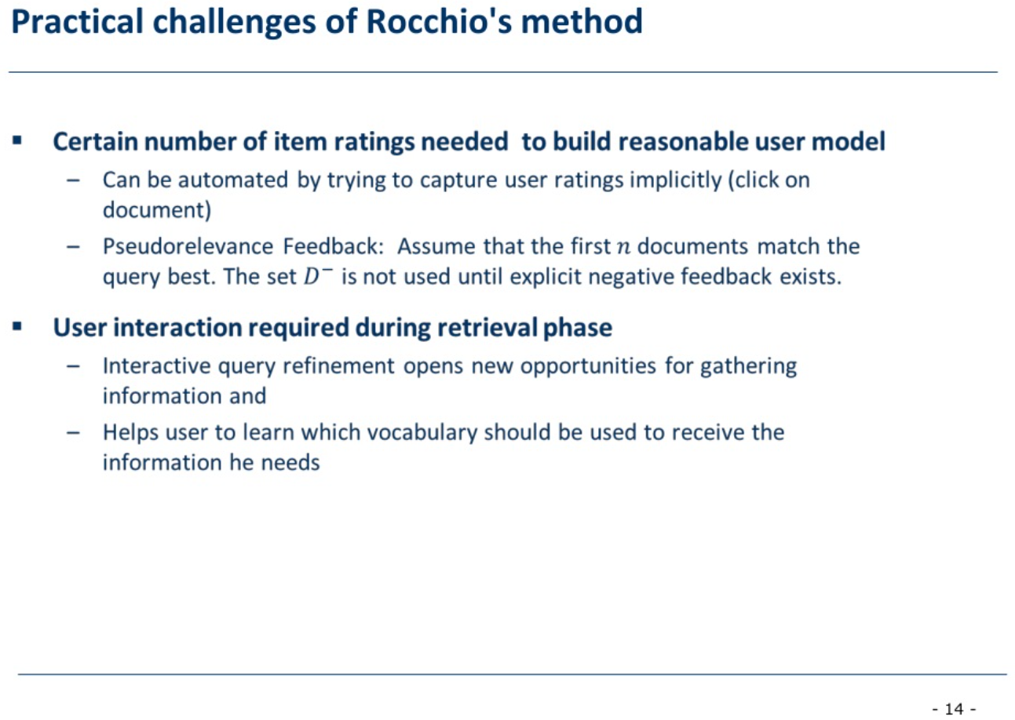

Slide 15
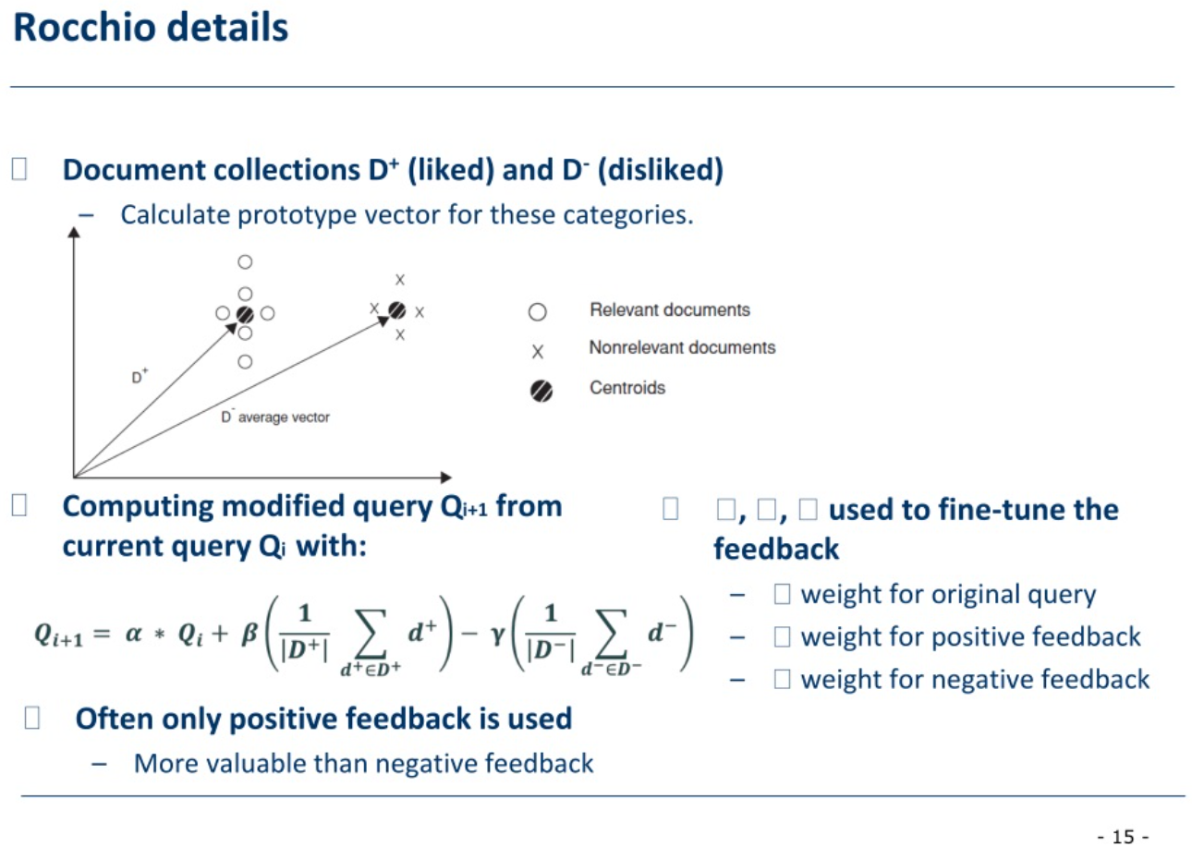

Slide 16
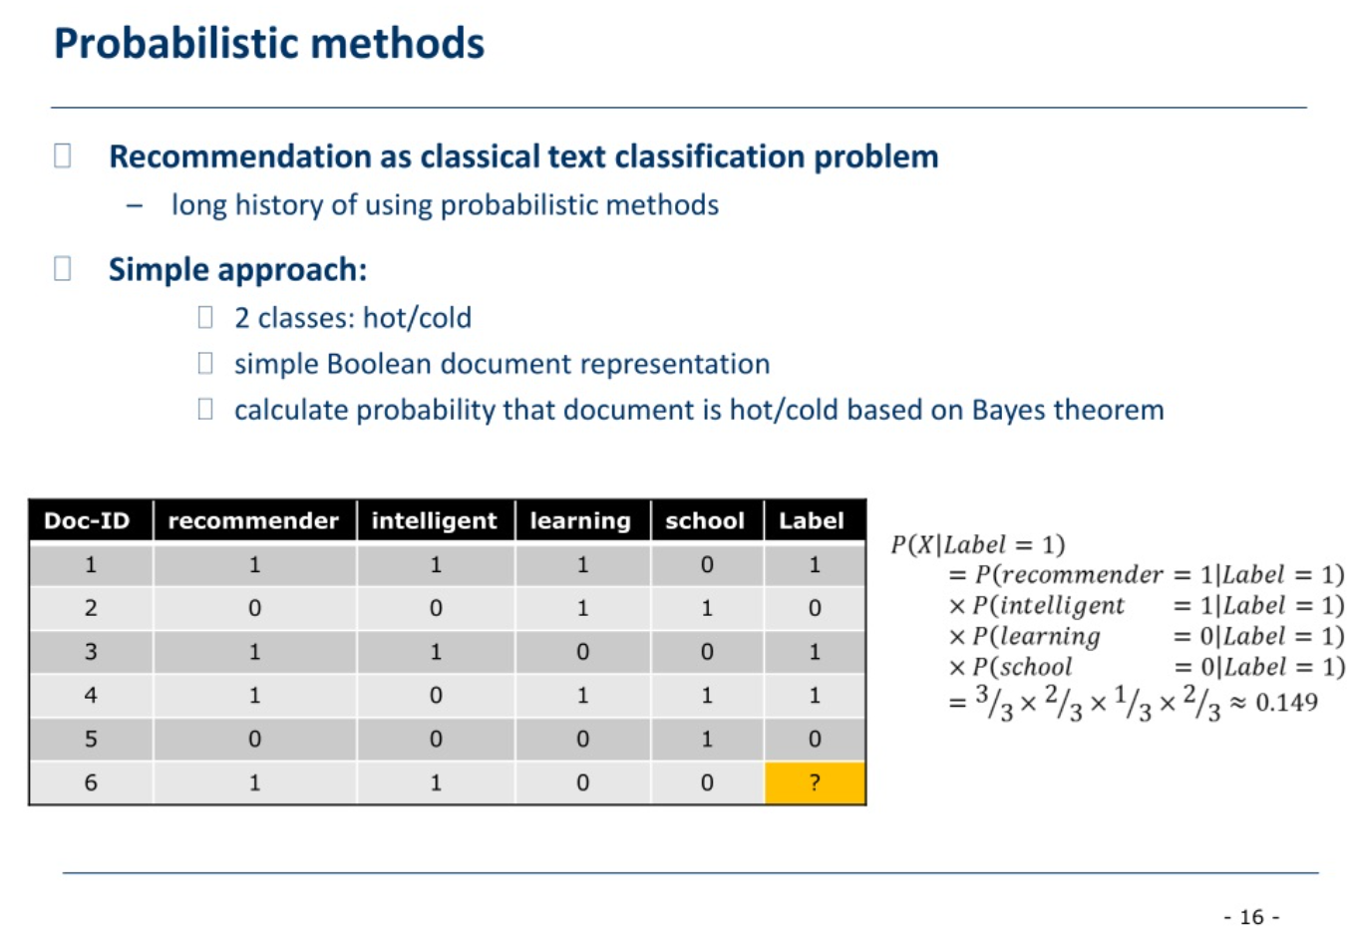

Slide 17
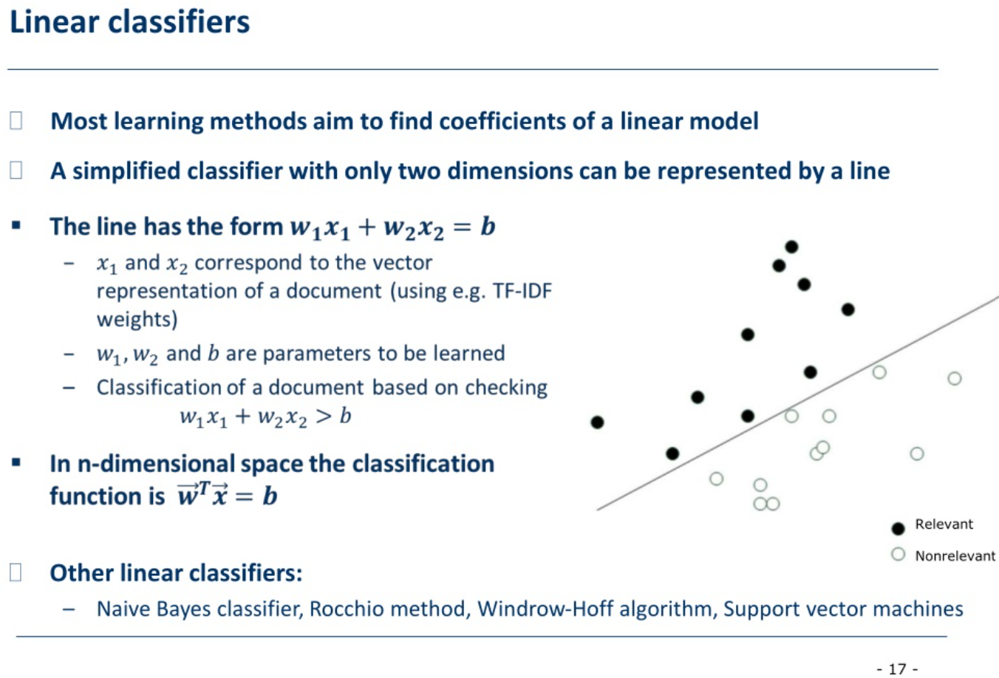

Slide 18
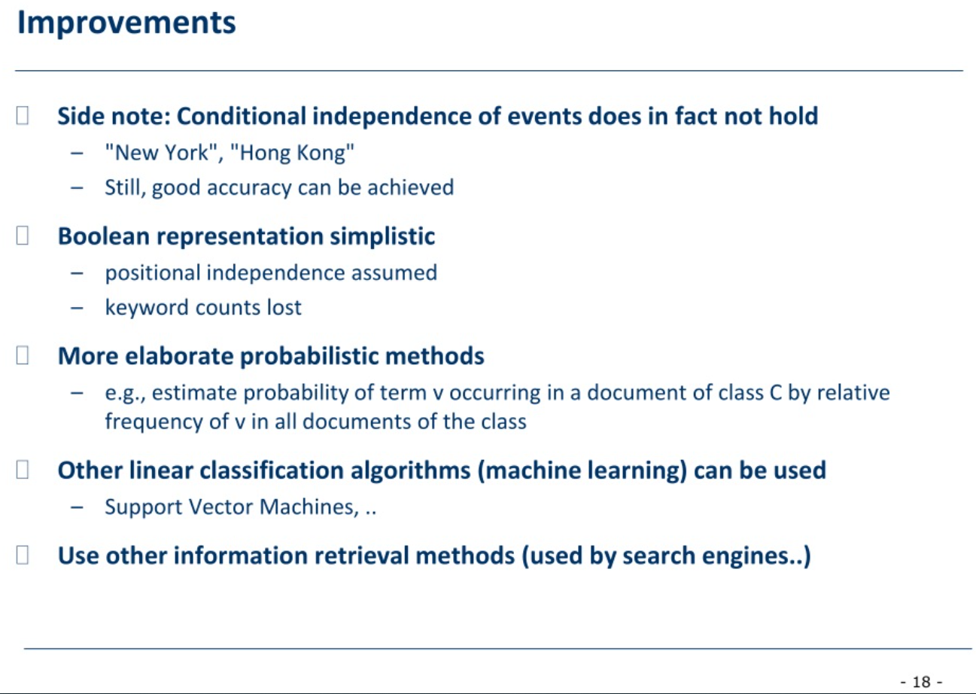

Slide 19
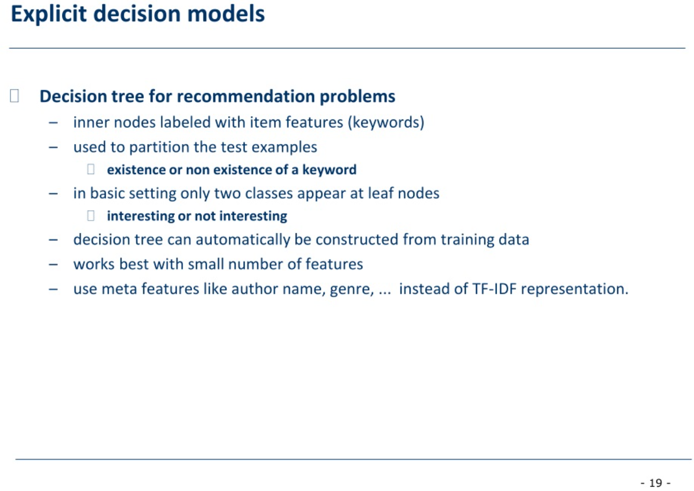

Slide 20
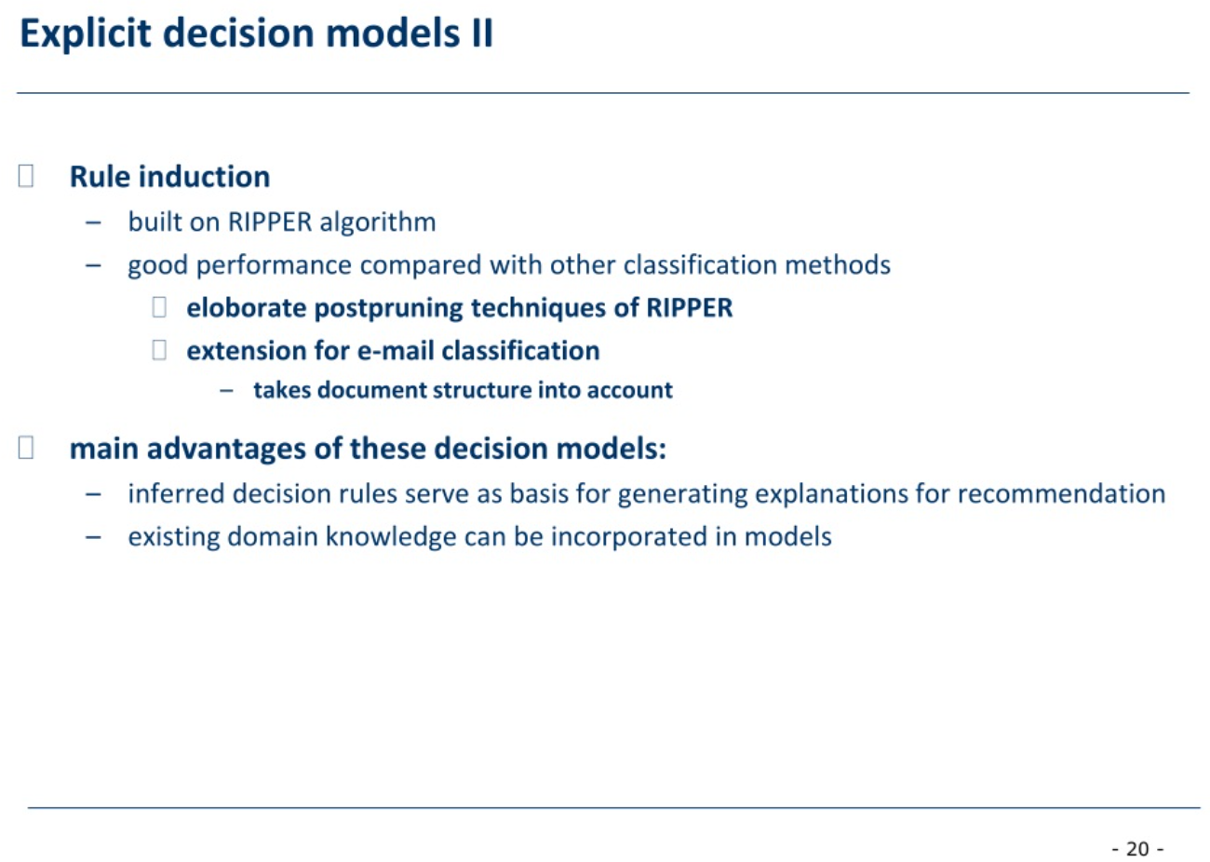

Slide 21
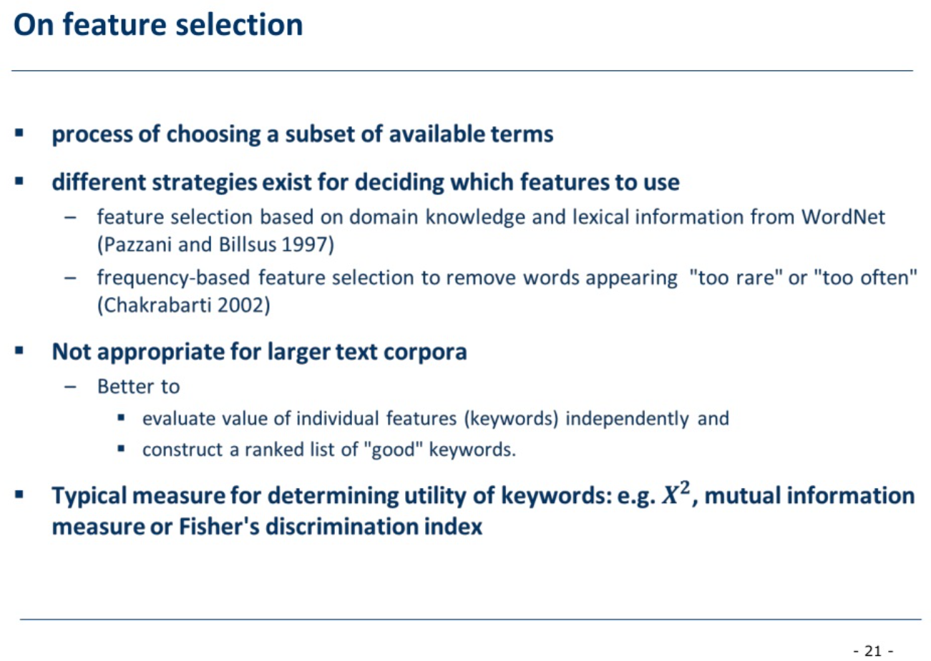

Slide 22
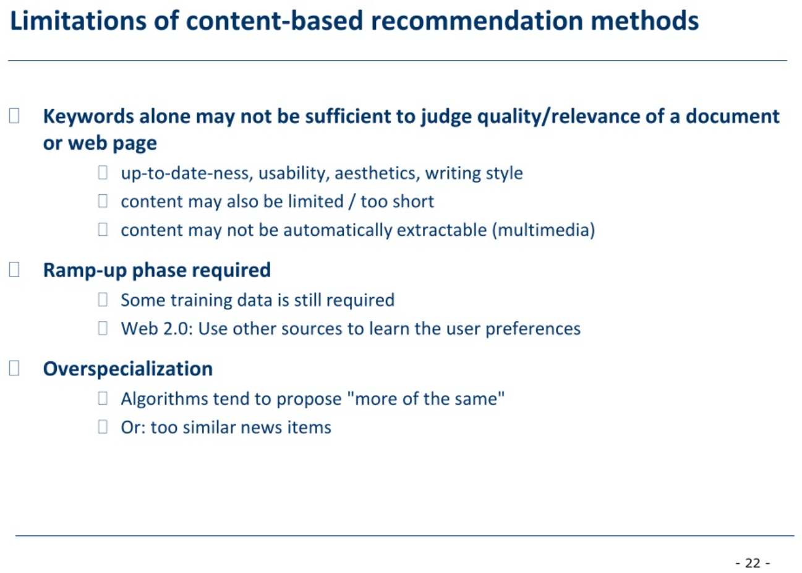

Slide 23
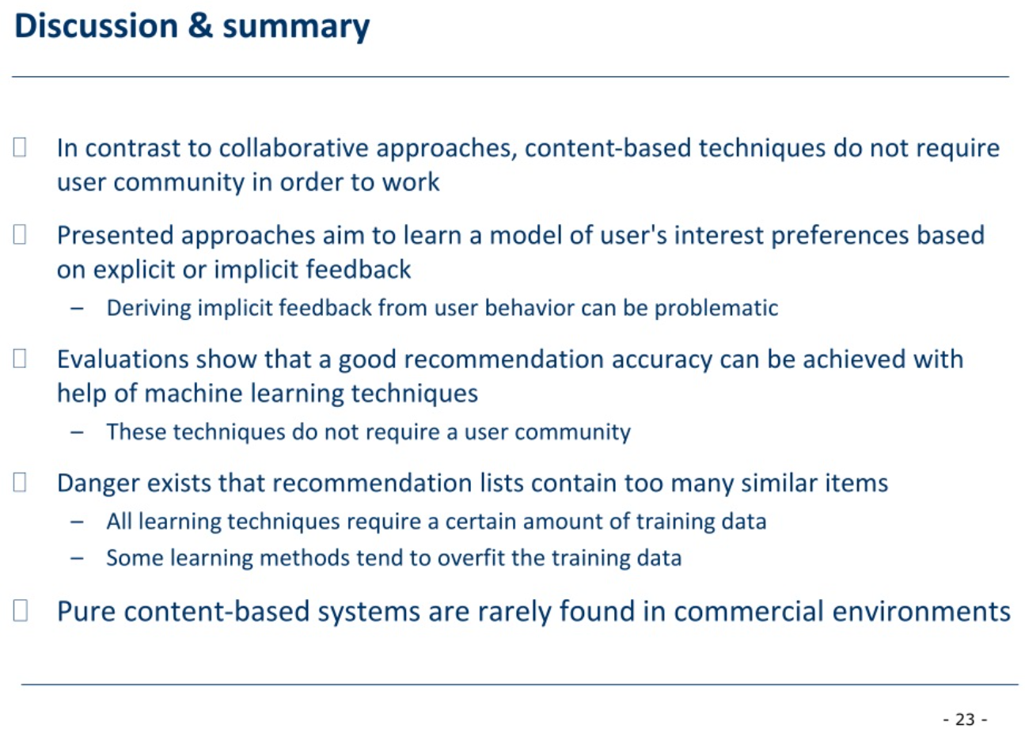

Slide 24
